Slide 1





Name: Ntuthuko France
Surname: Sibiya
Mentor: Aradhna Ramdeyal
Division: Sustainability
Technician in Training
Qualification: National Diploma
Studied: Tshwane University of Technology

Slide 2
Table of Content
  Eskom life Saving Rules
  Courses
  Version Control System
  Git and GitHub
  Applications for Git and GitHub
  Advantages for Git and GitHub
  Conclusion
10 January 2017

Slide 3
Eskom Life Saving Rules
Eskom Life Saving Rules
Have a Permit to Work
Always Buckle up
Hook Up at Height
Open ,Isolate,Earth,Test ,Bond and insulate Before Touch
Be Sobber

Slide 4

Courses
10 January 2017

Slide 5
Version Control System
A Version Control System (VCS) is a software that helps software developers to work together and maintain a complete history of their work.
A Version Control System allows every user to revert files back to a previous state, revert the entire project back to a previous state, review changes made over time, see who last modified something that might be causing a problem.
Who introduced an issue and when, and more. Using a Version Control System also it means that if you screw things up or lose files, you can generally recovery easily

Slide 6
Functions for Version Control System
Allows developers to work simultaneously.
Does not allow overwriting each other’s changes.
Maintains a history of every version.
Every Version Control System tool provides a private workplace as a working copy. Developers make changes in their private workplace and after commit, these changes become a part of the repository.
Git takes it one step further by providing them a private copy of the whole repository. Users can perform many operations with this repository such as add file, remove file, rename file, move file, commit changes, and many more.
10 January 2017

Slide 7
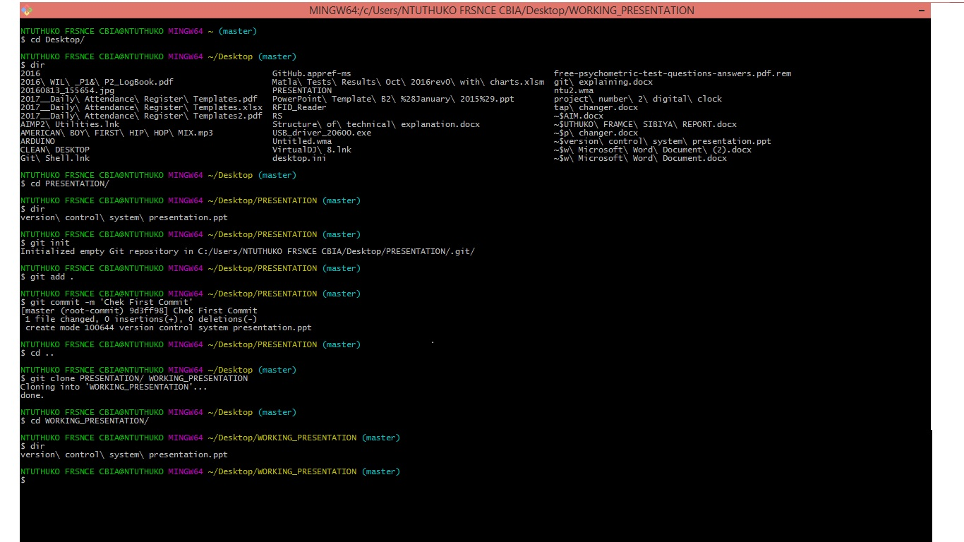
Git
Git:
Git is a free and open source distributed version control system designed to handle everything from small to very large projects with speed and efficiency. Git is mostly based on command line operation.

Slide 8
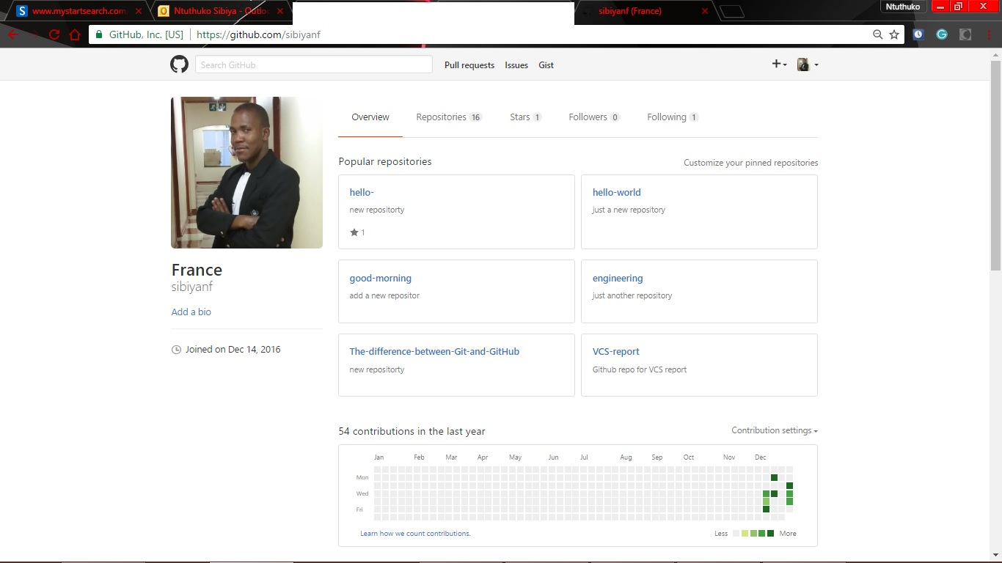
Heading
GitHub:
GitHub is a web-based Git repository hosting service, which offers all of the distributed revision control and source code management (SCM) functionality of Git as well as adding its own features.
It provides access control and several collaboration features such as bug tracking, feature requests, task management, and wikis for every project. GitHub offers both plans for private repositories, and free accounts which are commonly used to host open-source software projects.

Slide 9
Heading
Add
Add
Add
Add
Add

Slide 10
Heading
Add
Add
Add
Add
Add
Add
Add
Add

Slide 11
Heading
Add
Add
Add
Add

Slide 12

Thank you
Please note: this slide may also be used as a chapter divider slide.
To duplicate this slide, you need to first select this slide, go to the “Insert” drop down menu and select “Duplicate slide”. The duplicated slide can then be dragged to the appropriate position within your presentation.

